Slide 1
BELIEVER’S CHURCH
HOSPITAL PROJECT
THIRUVELLA – KERALA
GFRC FACADES

Slide 2
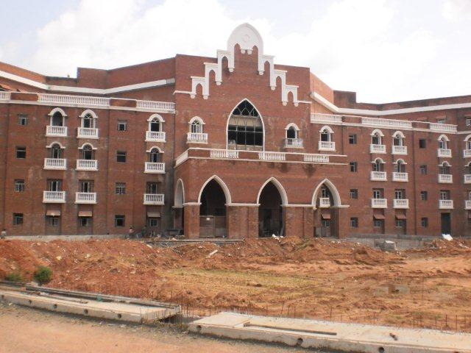
THE CREST – MODULE IN GRC

Slide 3
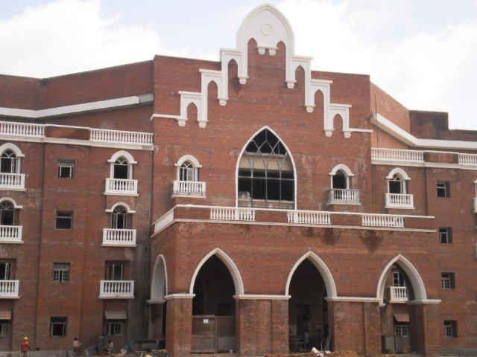
THEWINDOW SURROUNDS

Slide 4
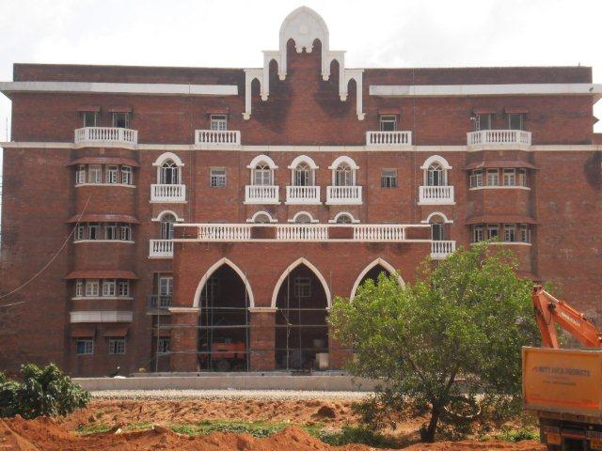
THE ARCH

Slide 5
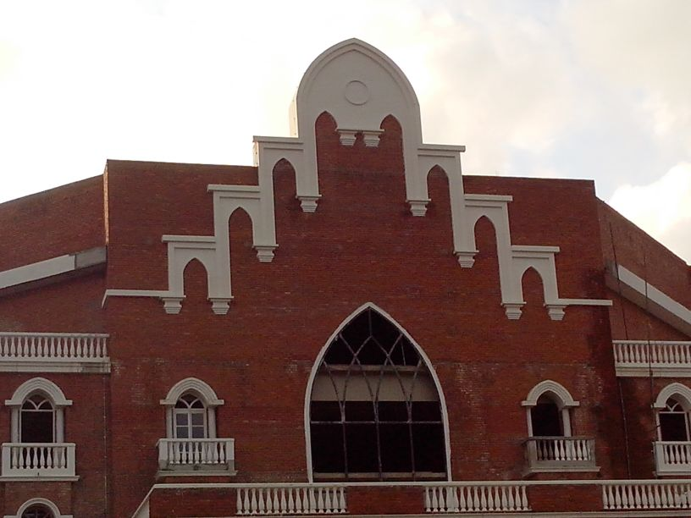
THE CREST

Slide 6
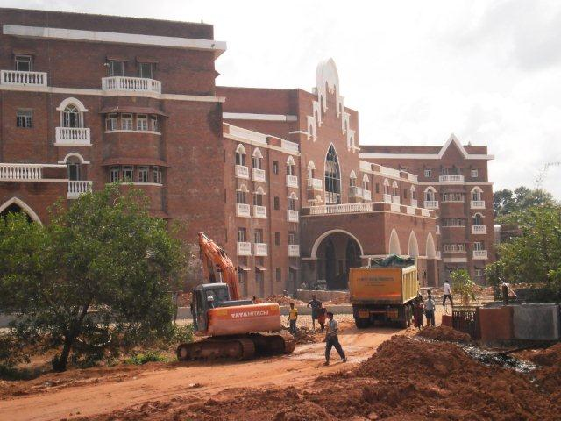
SIDE VIEW

Slide 7
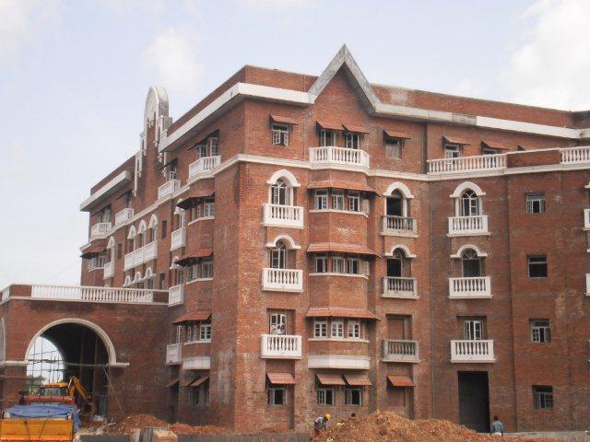
SIDE VIEW

Slide 8
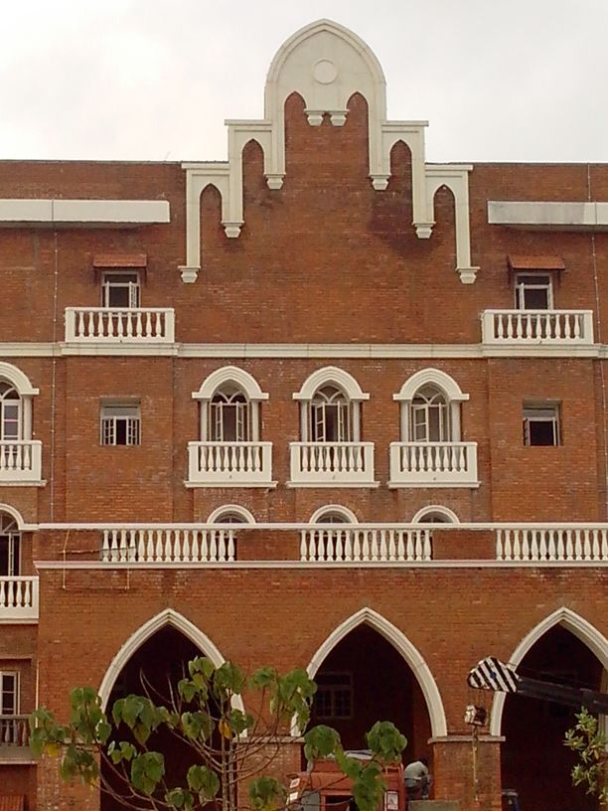
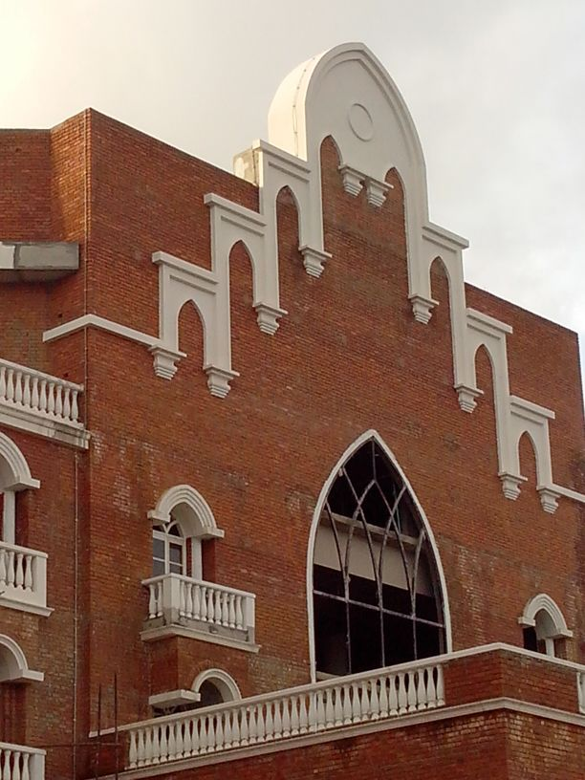
THE BALCONY BALUSTERADE

Slide 9
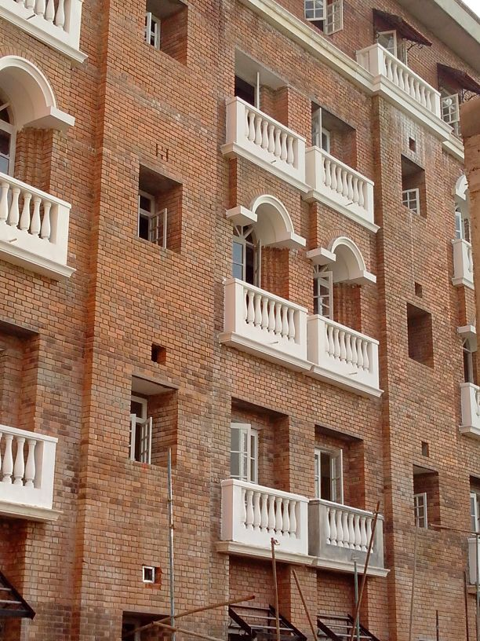
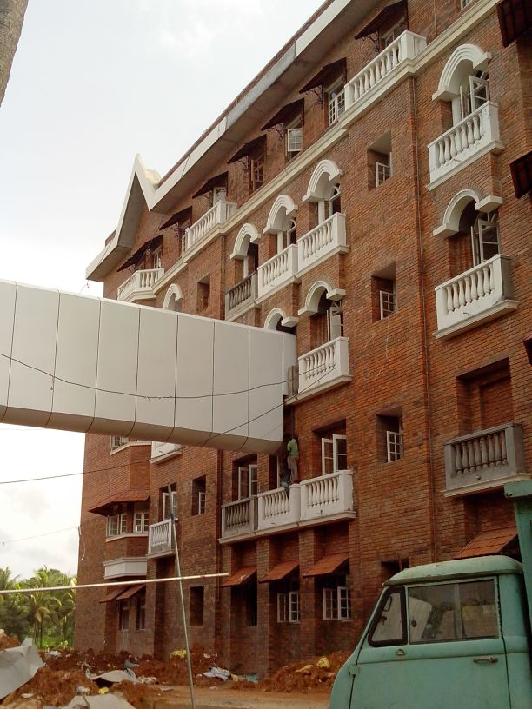
SIDE VIEW

Slide 10
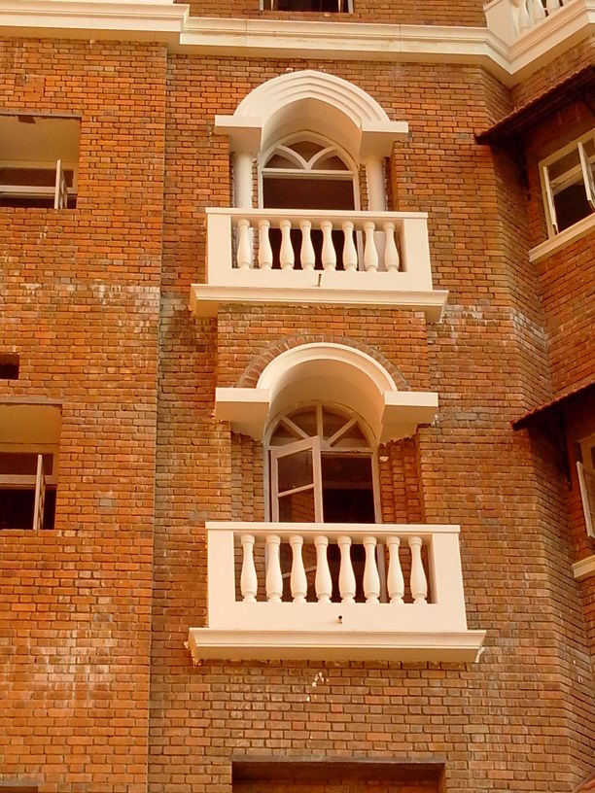
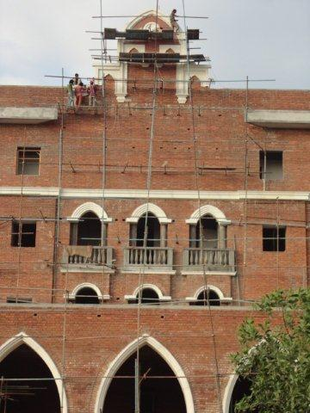
GRC AT ITS BEST
WINDOW SURROUND
FIXING OF THE CREST

Slide 11
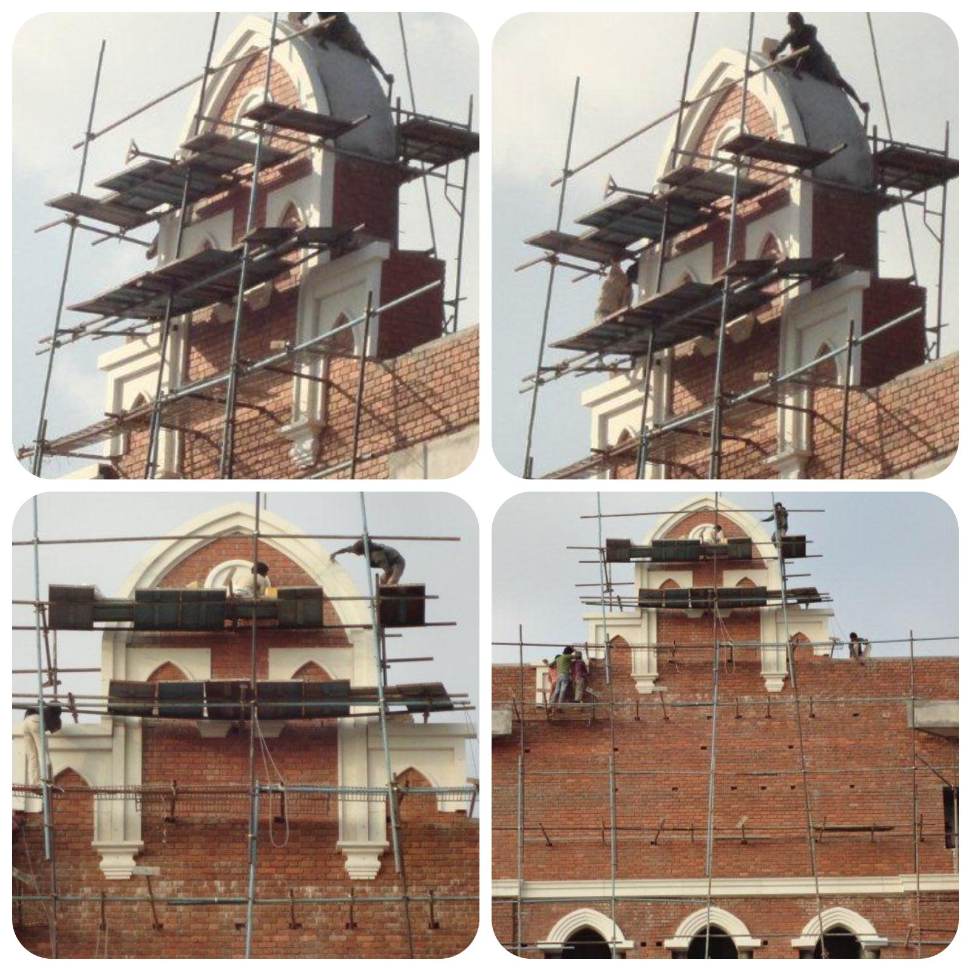
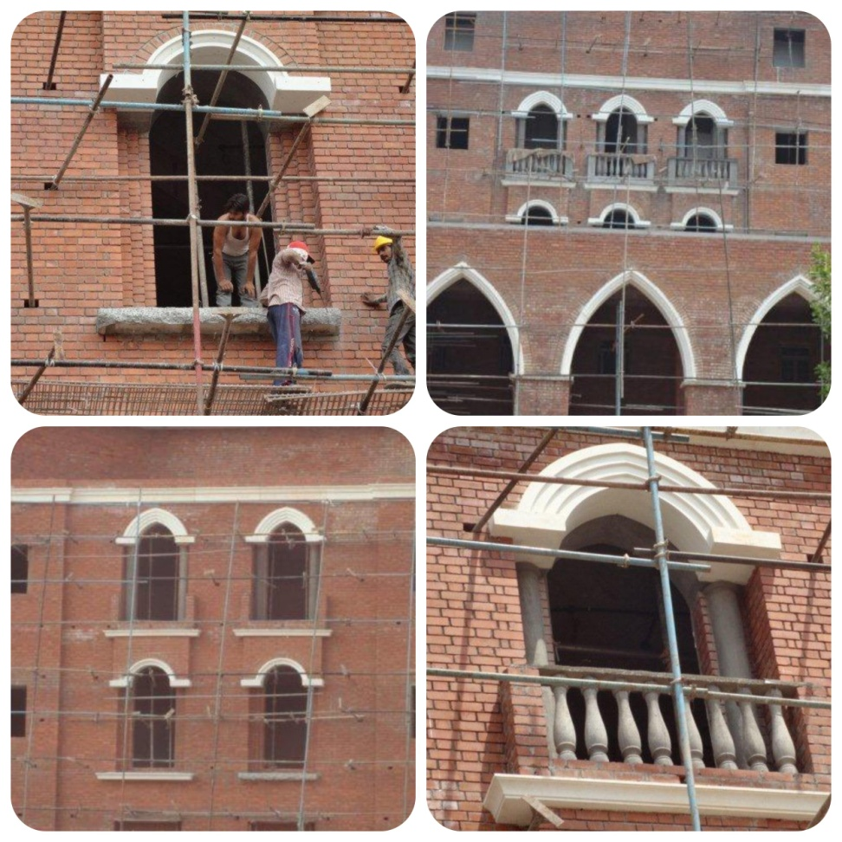
INSTALLATION WORKS IN PROGRESS

Slide 12
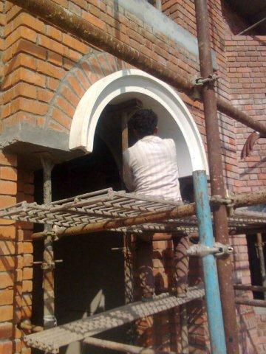
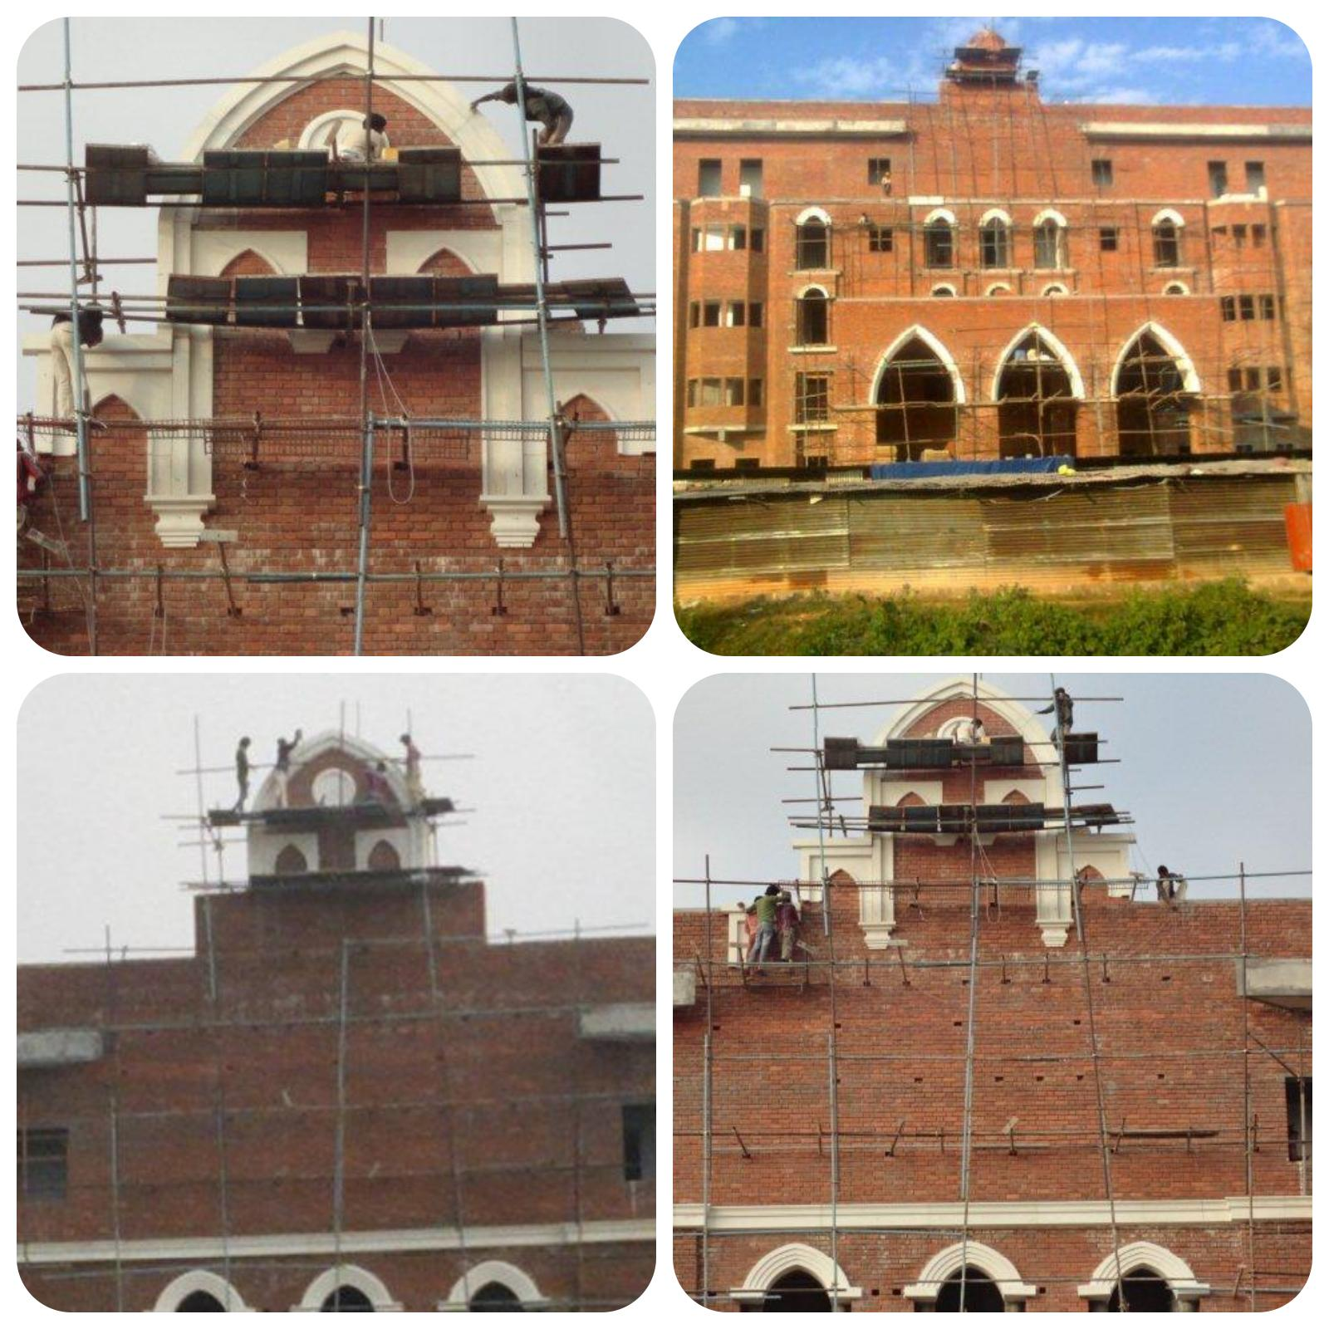
INSTALLATION WORKS IN PROGRESS

Slide 13
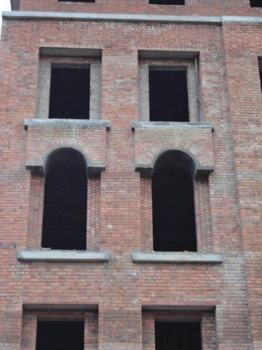
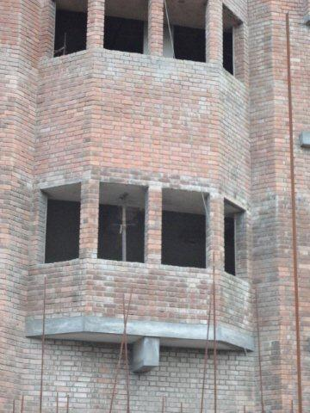
SITE POSITION
BEFORE GRC DRESSING

Slide 14
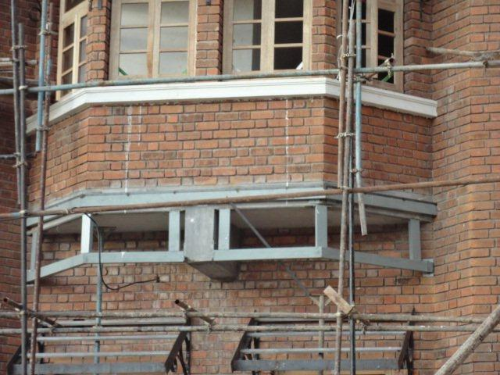
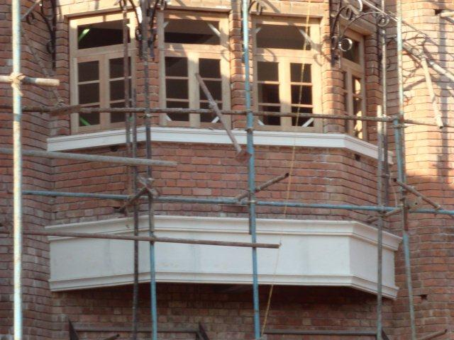
FRAME WORK & FIXED GRC BAND

Slide 15
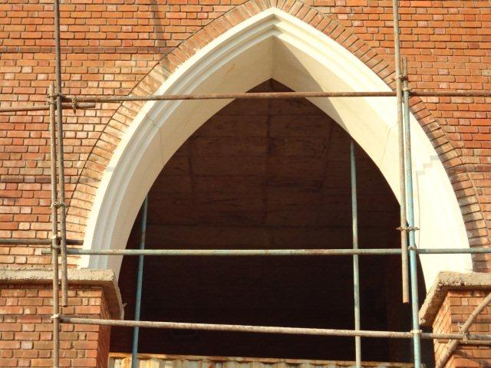
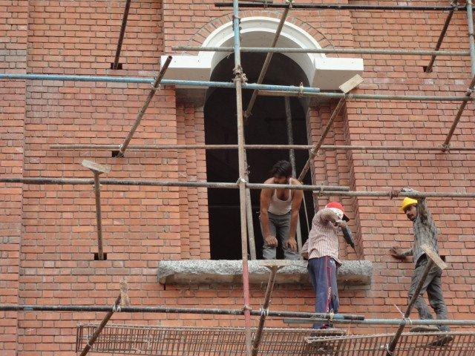
THE ARCH & SURROUND

Slide 16
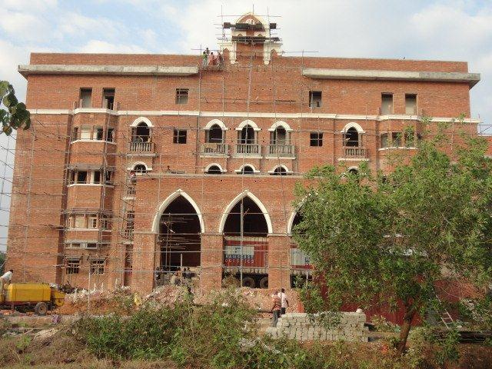
FIXING IN PROGRESS

Slide 17
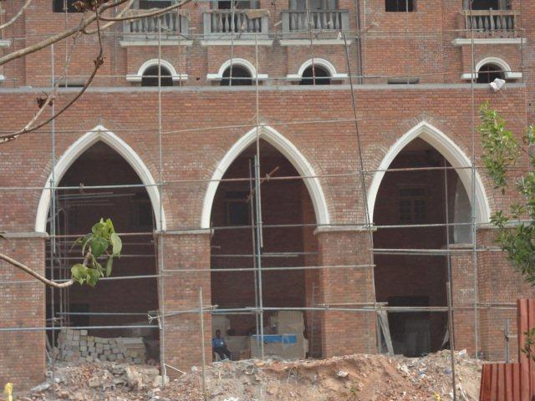
ARCH – AT ENTRANCE

Slide 18
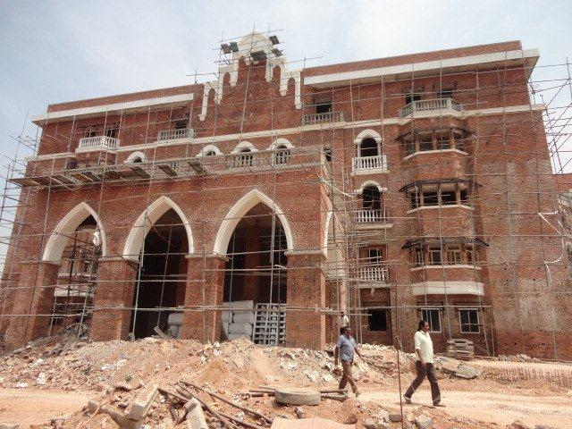
THE MAIN ENTRANCE

Slide 19
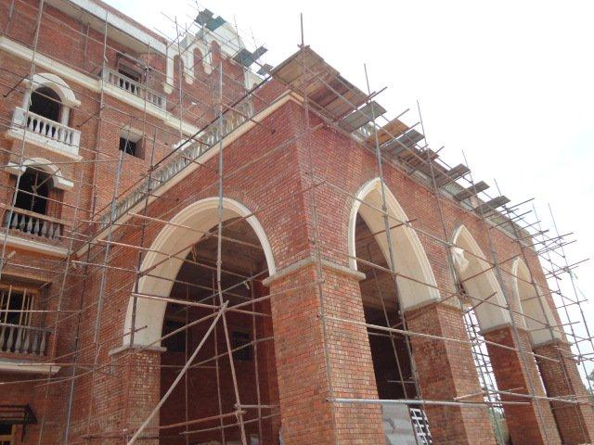
THE ARCH

Slide 20
GRC FIXING

Slide 21
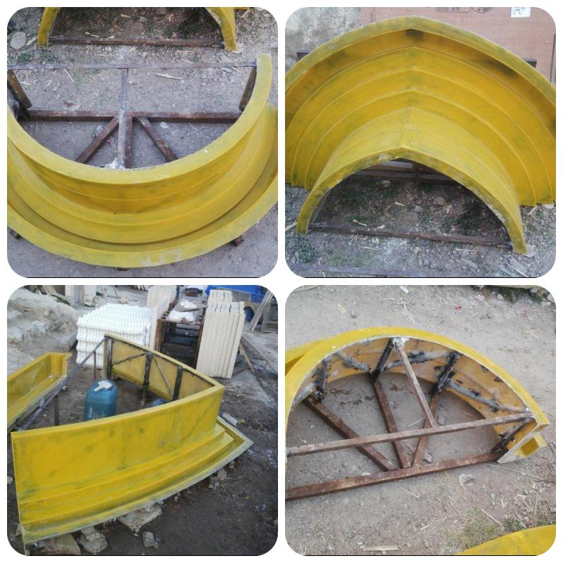
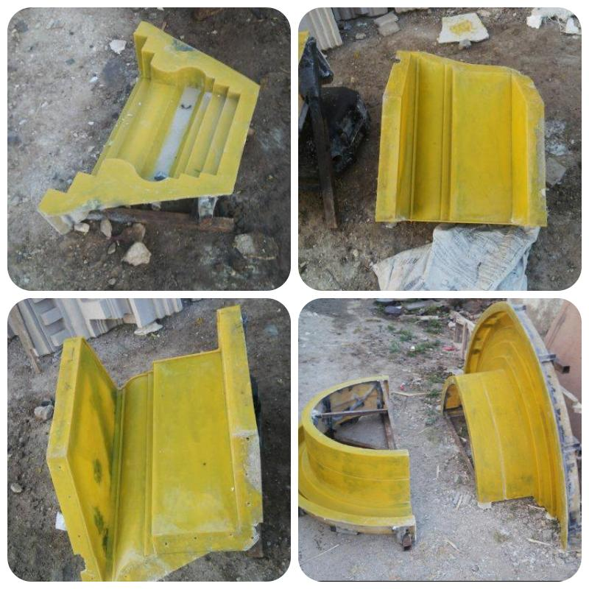
THE MOLDS

Slide 22
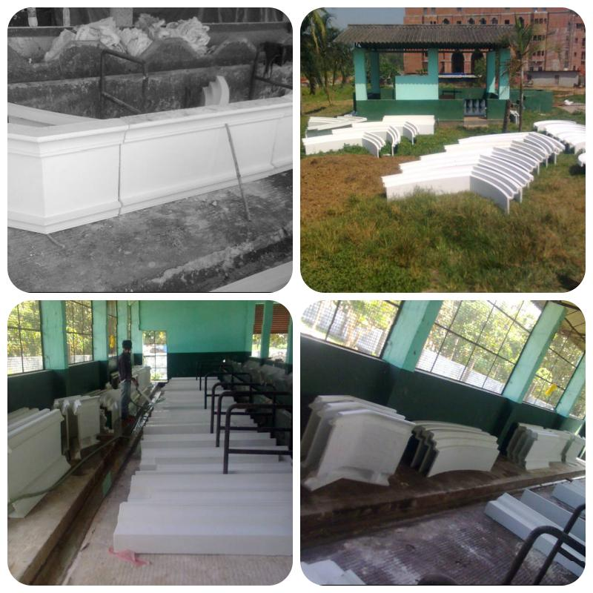
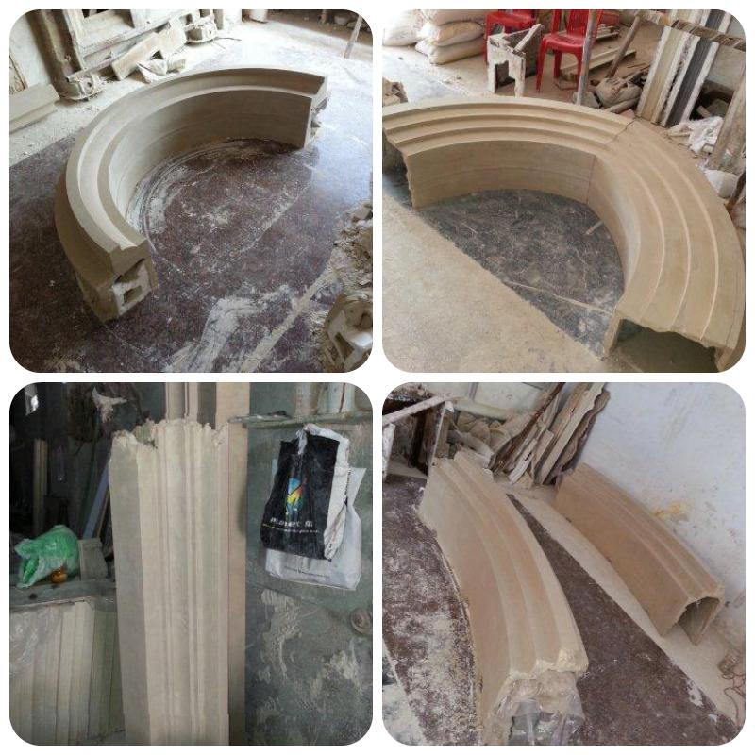
CASTED GRC ELEMENTS AT SITE

Slide 23
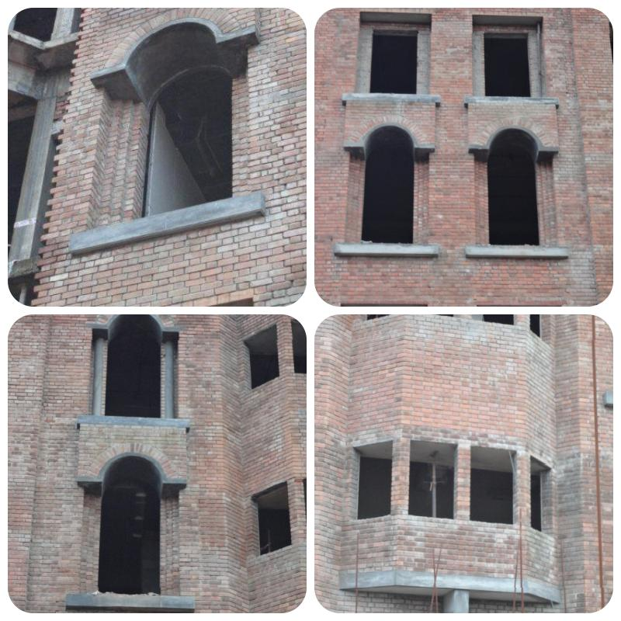
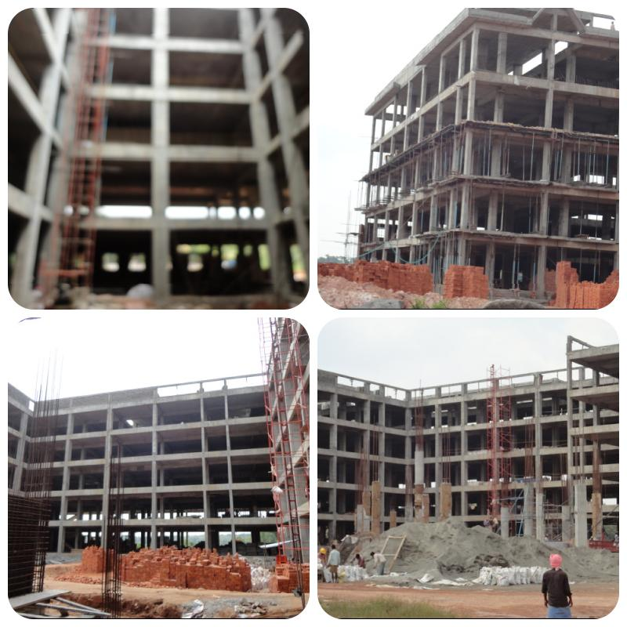
SITE POSITION BEFORE GRC WORKS

Slide 24
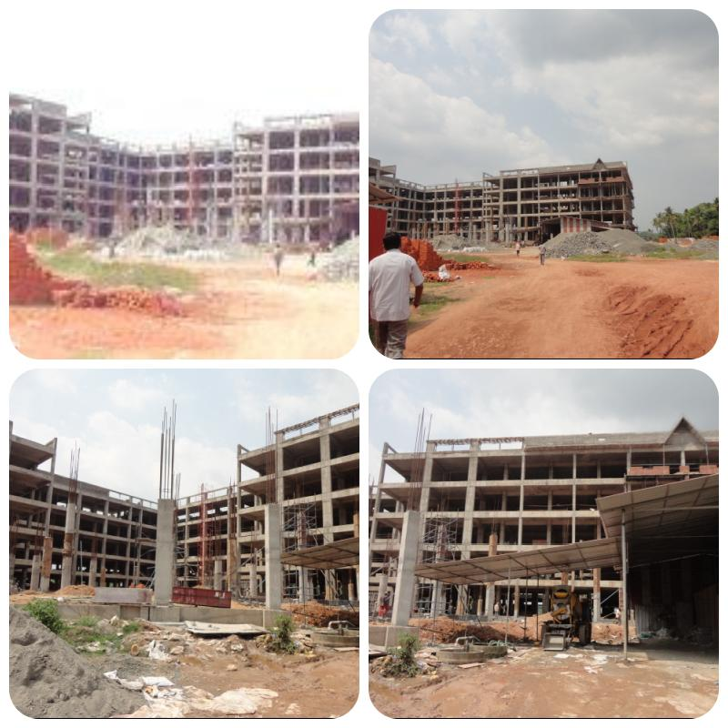
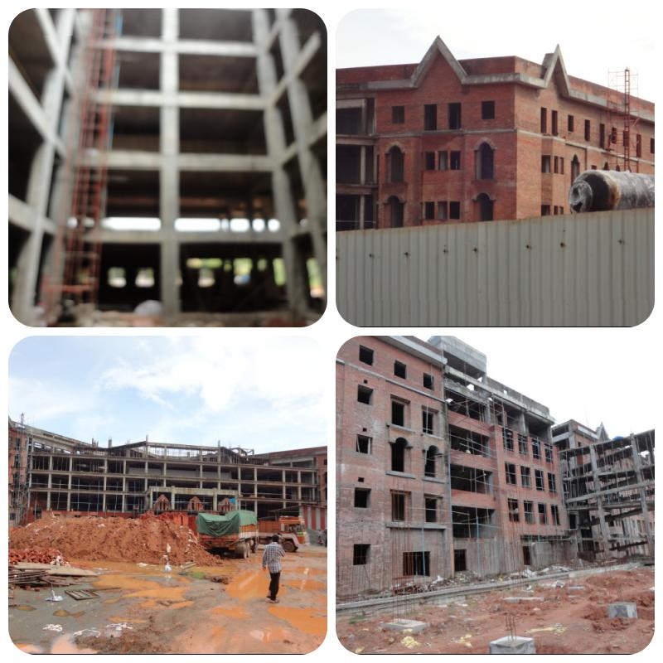
SITE POSITION BEFORE GRC WORKS

Slide 25
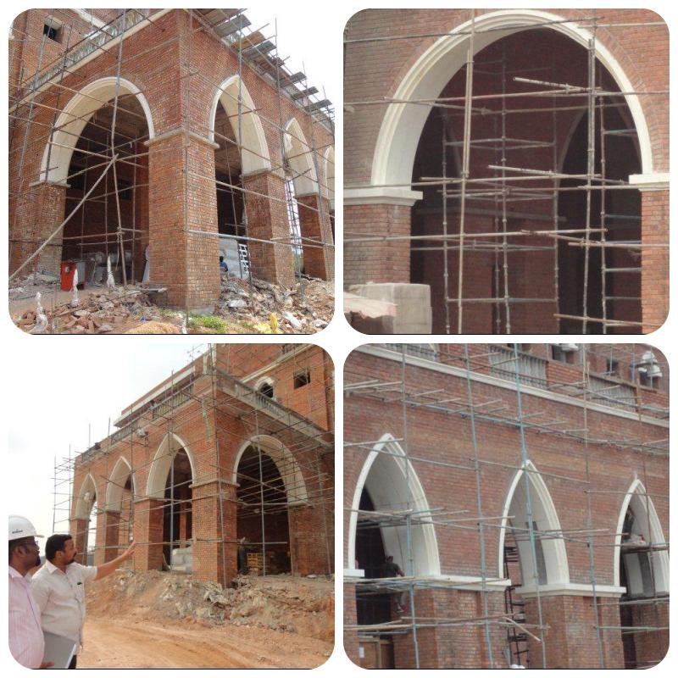
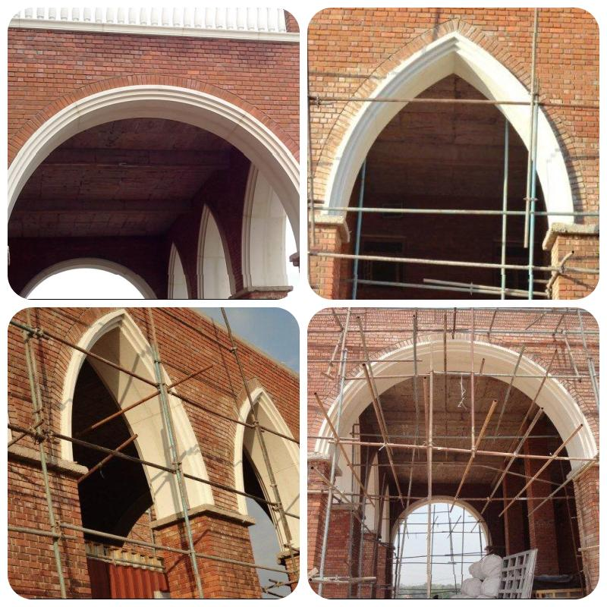
THE ARCHES

Slide 26
CONTACT DETAILS
GFRC FACADES.
GFRC / GRC, GRG CEILINGS & PANELS, FRP WORKS, HIGH END DECORATIVE & ARCHITECTURAL WORKS & ACOUSTIC SOLUTIONS WITH EXPERTISE IN HOME THEATRES
SRIHARI NILKAR
MUMBAI
Mobile: 09867569395
nilkarsrihari@gmail.com

